Slide 1
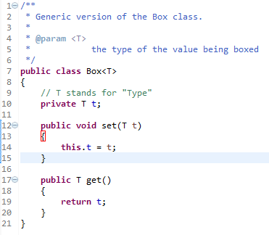
Raw Types
A raw type is the name of a generic class or interface without any type arguments
To create a parameterized type of Box<T>, you supply an actual type argument for the formal type parameter T:
If the actual type argument is omitted, you create a raw type of Box<T>:
Therefore, Box is the raw type of the generic type Box<T>. However, a non-generic class or interface type is not a raw type.

Slide 2





Raw Types
Raw types show up in legacy code because lots of API classes (such as the Collections classes) were not generic prior to JDK 5.0. When using raw types, you essentially get pre-generics behavior — a Box gives you Objects. For backward compatibility, assigning a parameterized type to its raw type is allowed:
But if you assign a raw type to a parameterized type, you get a warning:
You also get a warning if you use a raw type to invoke generic methods defined in the corresponding generic type.
The warning shows that raw types bypass generic type checks, deferring the catch of unsafe code to runtime. Therefore, you should avoid using raw types.

